Slide 1

Database Systems:
Design, Implementation, and Management
Tenth Edition
Chapter 1
Database Systems

Slide 2
Introduction
Good decisions require good information derived from raw facts
Data is managed most efficiently when stored in a database
Databases evolved from computer file systems
Understanding file system characteristics is important
Database Systems, 10th Edition

Slide 3
Why Databases?
Databases solve many of the problems encountered in data management
  Used in almost all modern settings involving data management:
    Business
    Research
    Administration
Important to understand how databases work and interact with other applications
Database Systems, 10th Edition

Slide 4
Data vs. Information
Data are raw facts
Information is the result of processing raw data to reveal meaning
Information requires context to reveal meaning
Raw data must be formatted for storage, processing, and presentation
Data are the foundation of information, which is the bedrock of knowledge
Database Systems, 10th Edition

Slide 5
Introducing the Database
Database: shared, integrated computer structure that stores a collection of:
  End-user data: raw facts of interest to end user
  Metadata: data about data
    Provides description of data characteristics and relationships in data
    Complements and expands value of data
Database management system (DBMS): collection of programs
  Manages structure and controls access to data
Database Systems, 10th Edition

Slide 6
Role and Advantages of the DBMS
DBMS is the intermediary between the user and the database
  Database structure stored as file collection
  Can only access files through the DBMS
DBMS enables data to be shared
DBMS integrates many users’ views of the data
Database Systems, 10th Edition

Slide 7
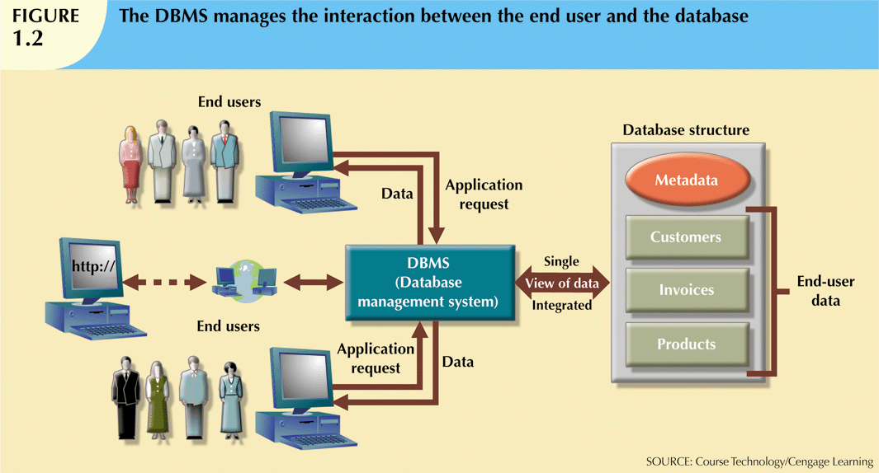
Database Systems, 10th Edition

Slide 8
Types of Databases
Databases can be classified according to:
  Number of users
  Database location(s)
  Expected type and extent of use
Single-user database supports only one user at a time
  Desktop database: single-user; runs on PC
Multiuser database supports multiple users at the same time
  Workgroup and enterprise databases
Database Systems, 10th Edition

Slide 9
Types of Databases (cont’d.)
Centralized database: data located at a single site
Distributed database: data distributed across several different sites
Operational database: supports a company’s day-to-day operations
  Transactional or production database
Data warehouse: stores data used for tactical or strategic decisions
Database Systems, 10th Edition

Slide 10
Types of Databases (cont'd.)
Unstructured data exist in their original state
Structured data result from formatting
  Structure applied based on type of processing to be performed
Semistructured data have been processed to some extent
Extensible Markup Language (XML) represents data elements in textual format
  XML database supports semistructured XML data
Database Systems, 10th Edition

Slide 11
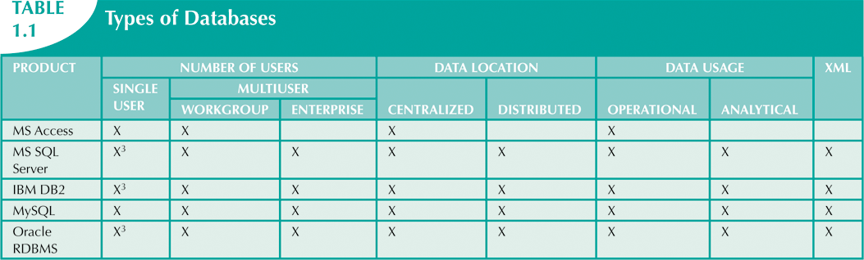
Database Systems, 10th Edition

Slide 12
Database Systems
Database system consists of logically related data stored in a single logical data repository
  May be physically distributed among multiple storage facilities
  DBMS eliminates most of file system’s problems
  Current generation stores data structures, relationships between structures, and access paths
    Also defines, stores, and manages all access paths and components
Database Systems, 10th Edition

Slide 13
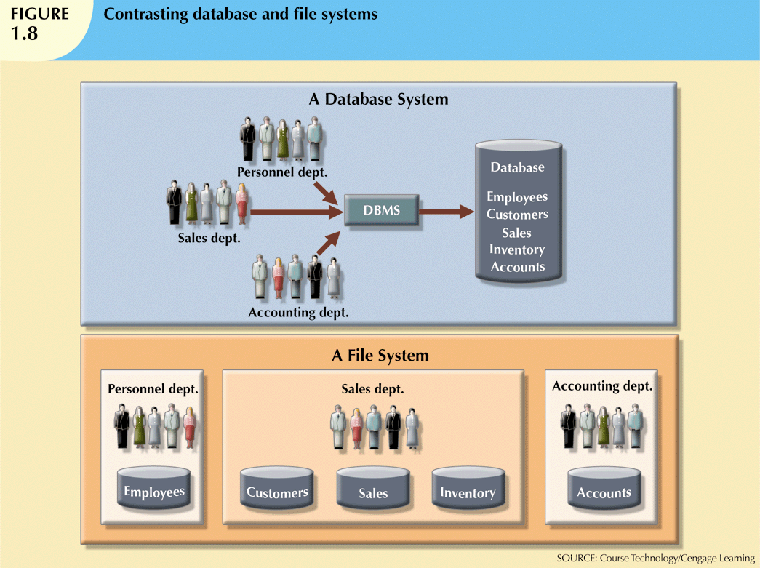
Database Systems, 10th Edition

Slide 14
The Database System Environment
Database system: defines and regulates the collection, storage, management, use of data
Five major parts of a database system:
  Hardware
  Software
  People
  Procedures
  Data
Database Systems, 10th Edition

Slide 15
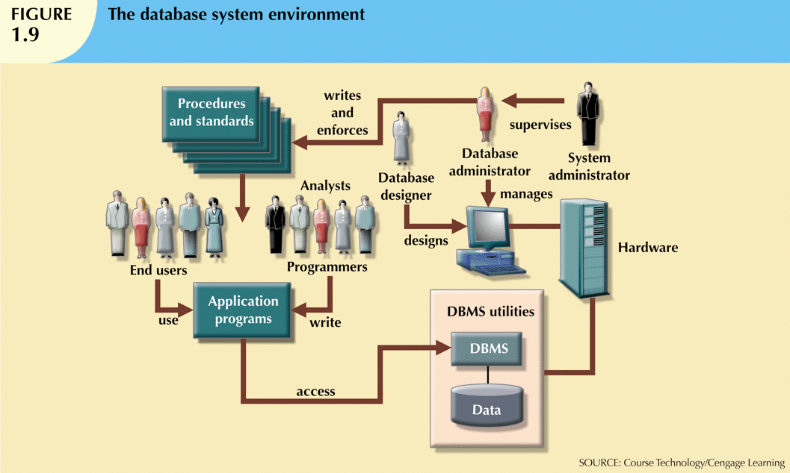
Database Systems, 10th Edition

Slide 16
The Database System Environment (cont'd.)
Hardware: all the system’s physical devices
Software: three types of software required
  Operating system software
  DBMS software
  Application programs and utility software
Database Systems, 10th Edition

Slide 17
The Database System Environment (cont'd.)
People: all users of the database system
  System and database administrators
  Database designers
  Systems analysts and programmers
  End users
Procedures: instructions and rules that govern the design and use of the database system
Data: the collection of facts stored in the database
Database Systems, 10th Edition

Slide 18
The Database System Environment (cont'd.)
Database systems are created and managed at different levels of complexity
Database solutions must be cost-effective as well as tactically and strategically effective
Database technology already in use affects selection of a database system
Database Systems, 10th Edition

Slide 19
DBMS Functions
Most functions are transparent to end users
  Can only be achieved through the DBMS
Data dictionary management
  DBMS stores definitions of data elements and relationships (metadata) in a data dictionary
  DBMS looks up required data component structures and relationships
  Changes automatically recorded in the dictionary
  DBMS provides data abstraction and removes structural and data dependency
Database Systems, 10th Edition

Slide 20
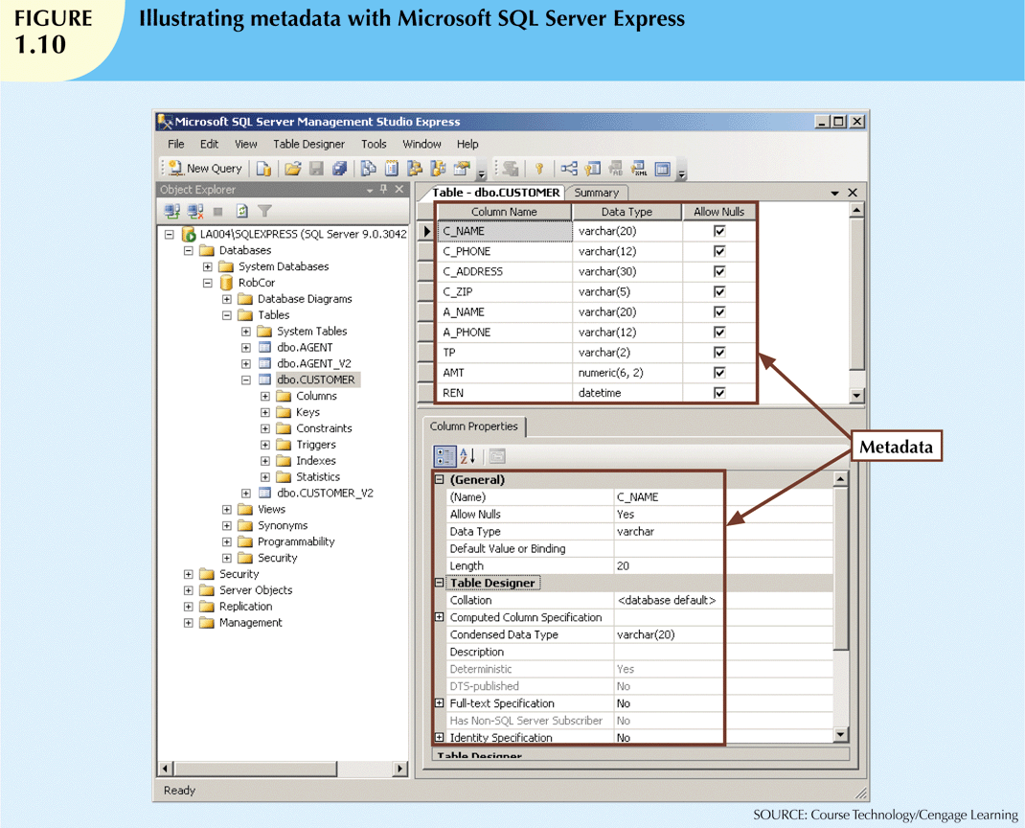
Database Systems, 10th Edition

Slide 21
DBMS Functions (cont'd.)
Data storage management
  DBMS creates and manages complex structures required for data storage
  Also stores related data entry forms, screen definitions, report definitions, etc.
  Performance tuning: activities that make the database perform more efficiently
  DBMS stores the database in multiple physical data files
Database Systems, 10th Edition

Slide 22
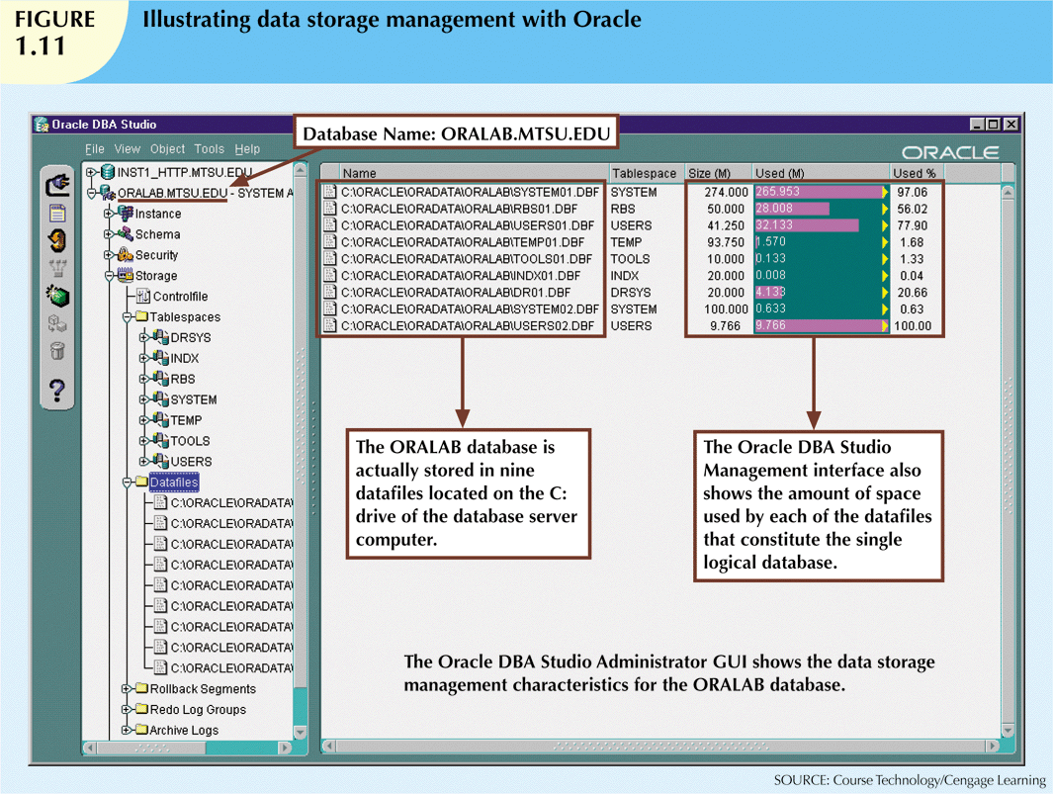
Database Systems, 10th Edition

Slide 23
DBMS Functions (cont'd.)
Data transformation and presentation
  DBMS transforms data entered to conform to required data structures
  DBMS transforms physically retrieved data to conform to user’s logical expectations
Security management
  DBMS creates a security system that enforces user security and data privacy
  Security rules determine which users can access the database, which items can be accessed, etc.
Database Systems, 10th Edition

Slide 24
DBMS Functions (cont'd.)
Multiuser access control
  DBMS uses sophisticated algorithms to ensure concurrent access does not affect integrity
Backup and recovery management
  DBMS provides backup and data recovery to ensure data safety and integrity
  Recovery management deals with recovery of database after a failure
    Critical to preserving database’s integrity
Database Systems, 10th Edition

Slide 25
DBMS Functions (cont'd.)
Data integrity management
  DBMS promotes and enforces integrity rules
    Minimizes redundancy
    Maximizes consistency
  Data relationships stored in data dictionary used to enforce data integrity
  Integrity is especially important in transaction-oriented database systems
Database Systems, 10th Edition

Slide 26
DBMS Functions (cont'd.)
Database access languages and application programming interfaces
  DBMS provides access through a query language
  Query language is a nonprocedural language
  Structured Query Language (SQL) is the de facto query language
    Standard supported by majority of DBMS vendors
Database Systems, 10th Edition

Slide 27
DBMS Functions (cont'd.)
Database communication interfaces
  Current DBMSs accept end-user requests via multiple different network environments
  Communications accomplished in several ways:
    End users generate answers to queries by filling in screen forms through Web browser
    DBMS automatically publishes predefined reports on a Web site
    DBMS connects to third-party systems to distribute information via e-mail
Database Systems, 10th Edition

Slide 28
Summary
Data are raw facts
Information is the result of processing data to reveal its meaning
Accurate, relevant, and timely information is the key to good decision making
Data are usually stored in a database
DBMS implements a database and manages its contents
Database Systems, 10th Edition

Slide 29
Summary (cont'd.)
Metadata is data about data
Database design defines the database structure
  Well-designed database facilitates data management and generates valuable information
  Poorly designed database leads to bad decision making and organizational failure
Databases evolved from manual and computerized file systems
Database Systems, 10th Edition

Slide 30
Summary (cont'd.)
In a file system, data stored in independent files
  Each requires its own management program
Some limitations of file system data management:
  Requires extensive programming
  System administration is complex and difficult
  Changing existing structures is difficult
  Security features are likely inadequate
  Independent files tend to contain redundant data
    Structural and data dependency problems
Database Systems, 10th Edition

Slide 31
Summary (cont'd.)
Database management systems were developed to address file system’s inherent weaknesses
DBMS present database to end user as single repository
  Promotes data sharing
  Eliminates islands of information
DBMS enforces data integrity, eliminates redundancy, and promotes security
Database Systems, 10th Edition

